Slide 1

GIET UNIVERSITY
Data Structure and Algorithms

Slide 2
AVL Rotations & AVL Tree Construction
Topics to be Covered:
  Need of balancing a BST
  Balancing Factor of a Node in BST
  Pivot Node
  AVL Rotations
  Building AVL Tree

Slide 3
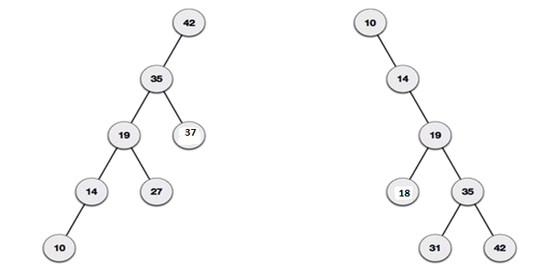
Need of Balancing a BST
What if the input to binary search tree comes in a sorted (ascending or descending) manner? It will then look like this −
It is observed that BST's worst-case performance is closest to linear search algorithms, that is Ο(n). In real-time data, we cannot predict data pattern and their frequencies. So, a need arises to balance out the existing BST.

Slide 4
Balancing Factor
Balance factor of a node in BST is the difference between height of left sub-tree and height of right sub-tree of it.
BF = H_{L} - H_{R}
Where
BF = Balance Factor
H_{L} = Height of Left Sub-tree
H_{R} = Height of Right Sub-tree
So, A BST is height balanced if all its nodes have a BF within the range of {-1,0,1} i.e. For every node in height balanced BST, BF ε { -1, 0 , 1 }

Slide 5
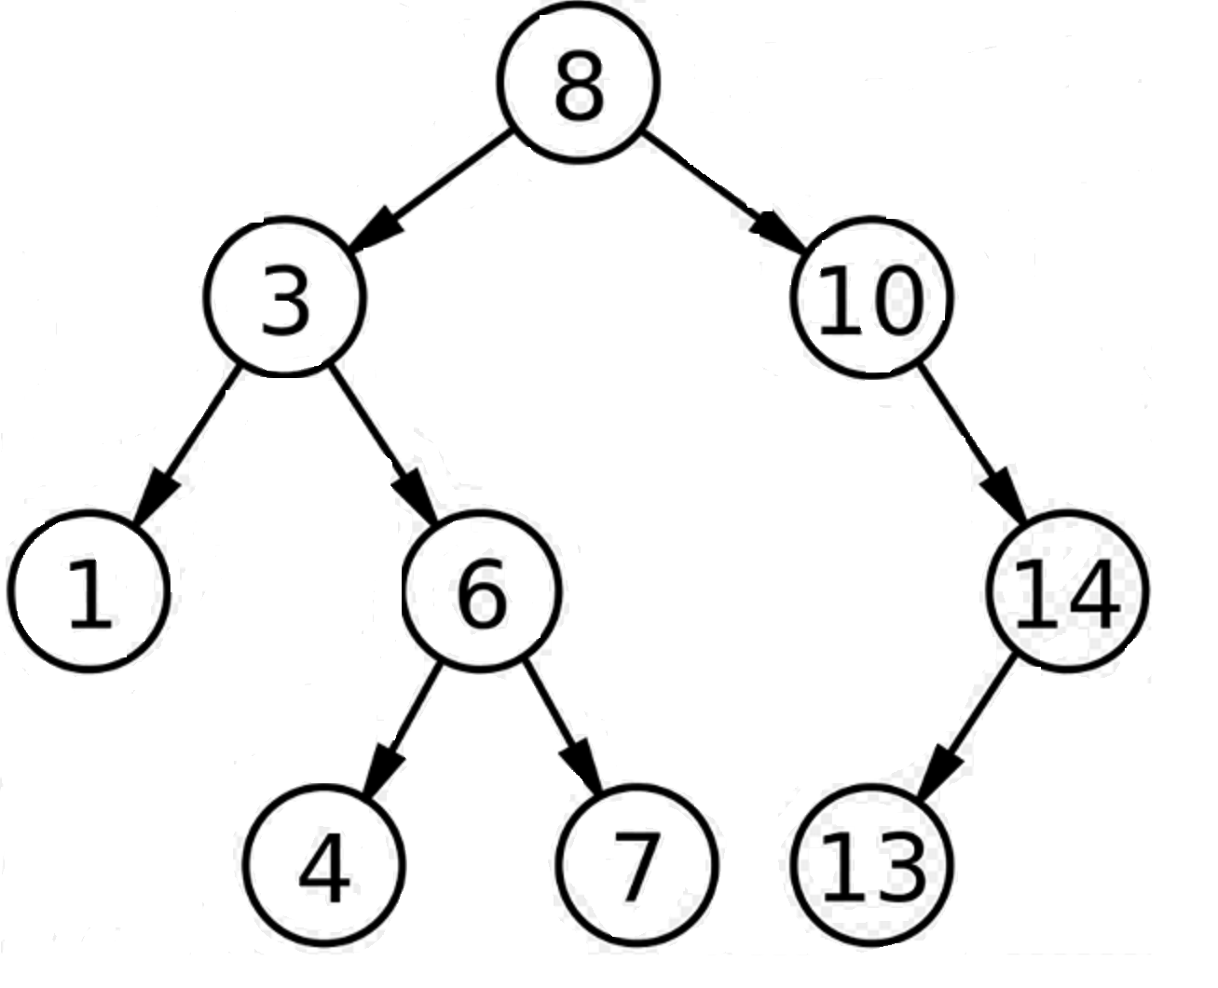
Ex: 1 Calculate BF of all nodes in the following BST

Slide 6
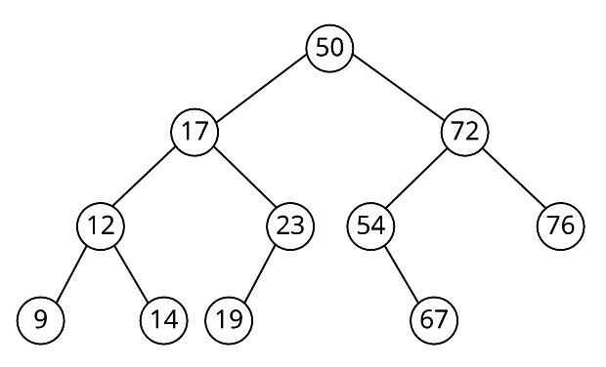
Ex: 2 Calculate BF of all nodes in the following BST

Slide 7
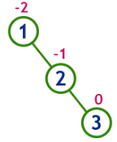
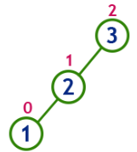
Pivot Node
Pivot node of a Binary Search Tree is the node where the tree gets imbalanced i.e. the node for which
  | Balance Factor | > 1
Insert 1, 2 and 3
Insert 3, 2 and 1
Here node 1 is the pivot node
Here node 3 is the pivot node

Slide 8
AVL Rotations
Assume a BST is balanced initially and the it becomes imbalanced due to insertion or deletion of a node.
Now, in order to make the tree balanced, we need to follow certain rotations methods.
The rotation methods were proposed by Russian mathematicians namely Adelson, Velskii and Landis and accordingly the rotations were named as AVL rotations.
There are 4 types of AVL Rotations:
  LL Rotation
  RR Rotation
  LR Rotation
  RL Rotation

Slide 9
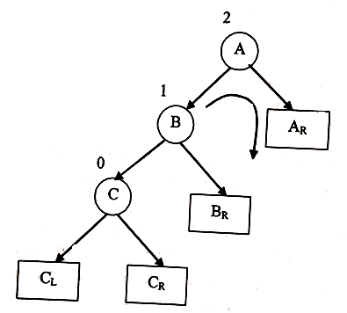
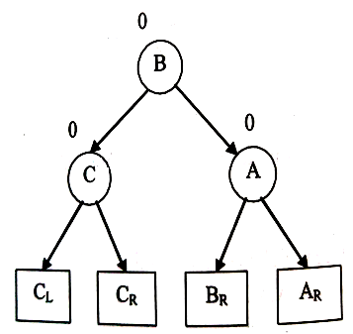
LL Rotation
When a Tree gets imbalanced due to insertion of a node at left of the left sub-tree of pivot node, we follow LL Rotation.
LL Rotation

Slide 10
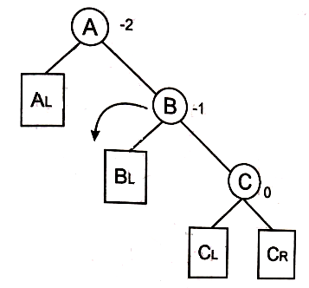
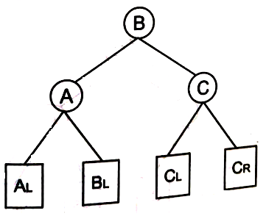
RR Rotation
When a Tree gets imbalanced due to insertion of a node at right of the right sub-tree of pivot node, we follow RR Rotation.
RR Rotation

Slide 11
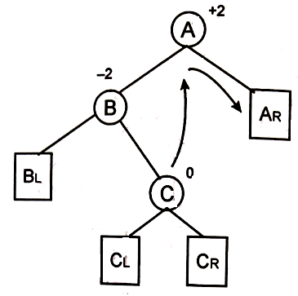
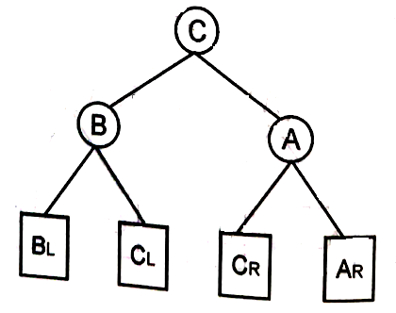
LR Rotation
When a Tree gets imbalanced due to insertion of a node at right of the left sub-tree of pivot node, we follow LR Rotation.
LR Rotation

Slide 12
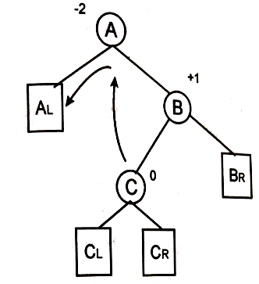
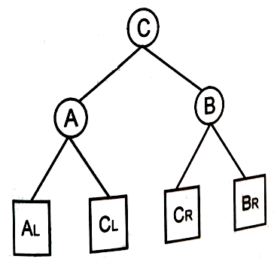
RL Rotation
When a Tree gets imbalanced due to insertion of a node at left of the right sub-tree of pivot node, we follow RL Rotation.
RL Rotation

Slide 13

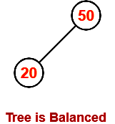
Building AVL Tree : An Example
Step-01: Insert 50
Construct AVL Tree for the following sequence of numbers:
50 , 20 , 60 , 10 , 8 , 15 , 32 , 46 , 11 , 48
Step-01: Insert 50
Step-02: Insert 20
As 20 < 50, so insert 20 in 50’s left sub tree.

Slide 14
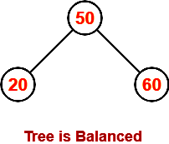
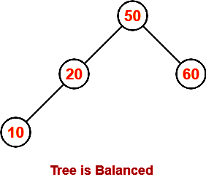
Step-03: Insert 60
As 60 > 50, so insert 60 in 50’s right sub tree.
Step-04: Insert 10
As 10 < 50, so insert 10 in 50’s left sub tree.
As 10 < 20, so insert 10 in 20’s left sub tree.

Slide 15
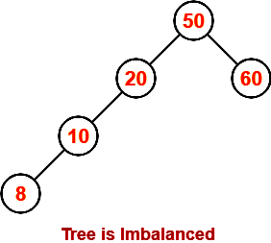
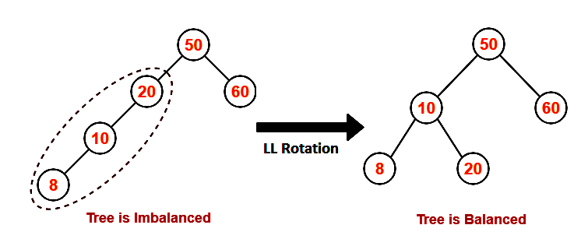
Step-05: Insert 8
As 8 < 50, so insert 8 in 50’s left sub tree.
As 8 < 20, so insert 8 in 20’s left sub tree.
As 8 < 10, so insert 8 in 10’s left sub tree.
To balance the tree:
  Find the first imbalanced node on the path from the newly inserted node (node 8) to the root node.
  The first imbalanced node is node 20.
  Now, count three nodes from node 20 in the direction of leaf node.
  Then, use AVL tree rotation to balance the tree.

Slide 16
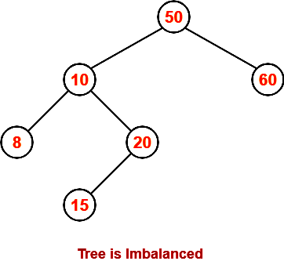
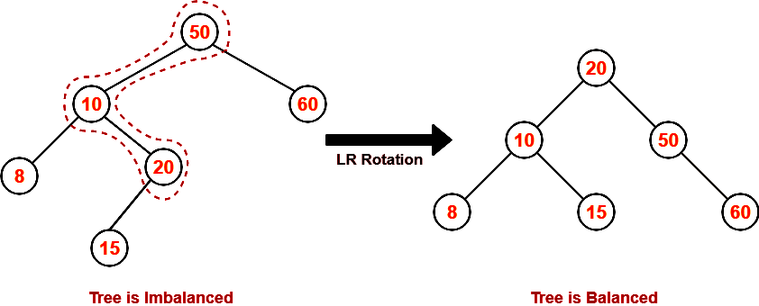
Step-06: Insert 15
As 15 < 50, so insert 15 in 50’s left sub tree.
As 15 > 10, so insert 15 in 10’s right sub tree.
As 15 < 20, so insert 15 in 20’s left sub tree.
To balance the tree,
  Find the first imbalanced node on the path from the newly inserted node (node 15) to the root node.
  The first imbalanced node is node 50.
  Now, count three nodes from node 50 in the direction of leaf node.
Then, use AVL tree rotation to balance the tree. Following this, we have-

Slide 17
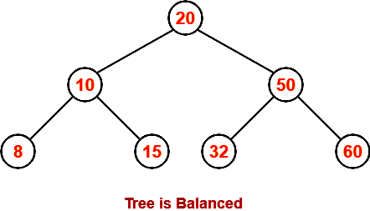
Step-07: Insert 32
As 32 > 20, so insert 32 in 20’s right sub tree.
As 32 < 50, so insert 32 in 50’s left sub tree.

Slide 18
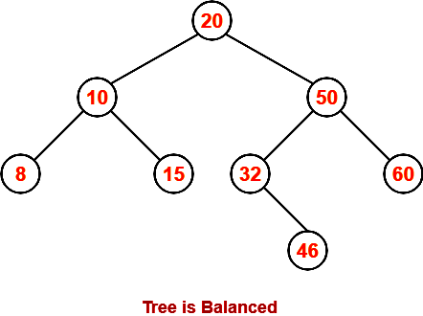
Step-08: Insert 46
As 46 > 20, so insert 46 in 20’s right sub tree.
As 46 < 50, so insert 46 in 50’s left sub tree.
As 46 > 32, so insert 46 in 32’s right sub tree.

Slide 19
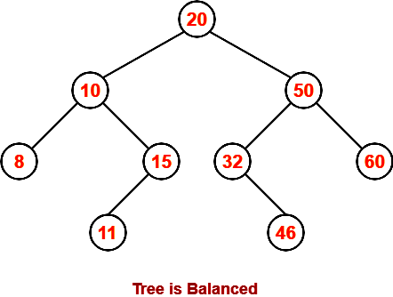
Step-09: Insert 11
As 11 < 20, so insert 11 in 20’s left sub tree.
As 11 > 10, so insert 11 in 10’s right sub tree.
As 11 < 15, so insert 11 in 15’s left sub tree.

Slide 20
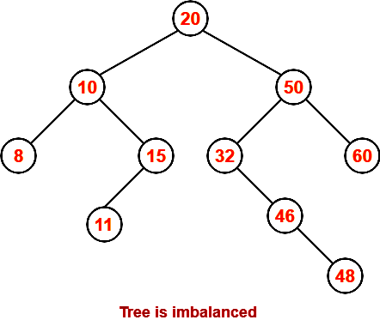
Step-10: Insert 48
As 48 > 20, so insert 48 in 20’s right sub tree.
As 48 < 50, so insert 48 in 50’s left sub tree.
As 48 > 32, so insert 48 in 32’s right sub tree.
As 48 > 46, so insert 48 in 46’s right sub tree.
Contd….

Slide 21
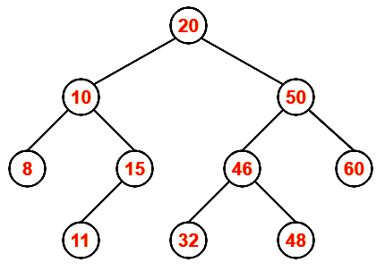
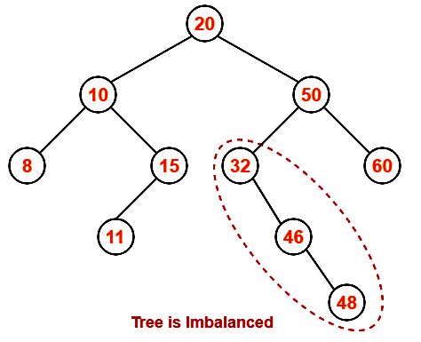
To balance the tree,
  Find the first imbalanced node on the path from the newly inserted node (node 48) to the root node.
  The first imbalanced node is node 32.
  Now, count three nodes from node 32 in the direction of leaf node.
  Then, use AVL tree rotation to balance the tree.
Following this, we have-
This is the final balanced AVL tree.

Slide 22
Assignment For You:
Q.1: Construct an AVL Tree by taking following sequence of input values:
50,60,70,15,10,33,22,35,25,40
Q.2: Construct an AVL Tree by taking following sequence of input values:
21,26,30,9,4,14,28,18,15,10,2,3,7
Q.3: Construct an AVL tree by taking 10 best friend’s name.

Slide 23
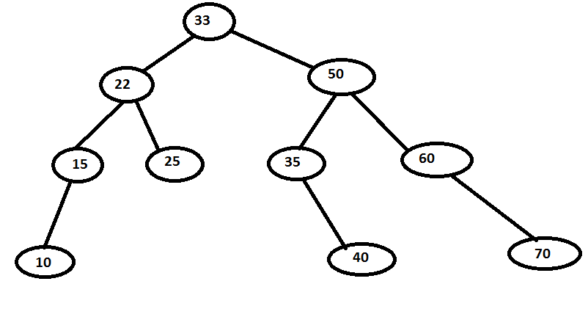
Solution 1 : Final AVL Tree

Slide 24
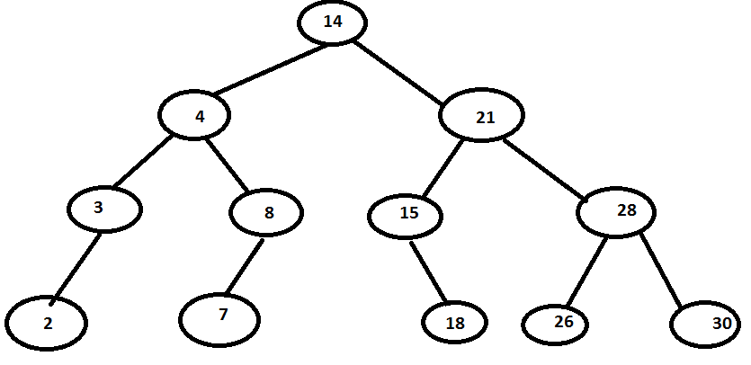
Solution 2 : Final AVL Tree

